Slide 1
Limit Equilibrium Procedures Part 1
CE 544 – BRIGHAM YOUNG UNIVERSITY

Slide 2
Slope Stability Analysis Methods
Map-based probabilistic analysis
Deformation analysis
Limit equilibrium analysis

Slide 3
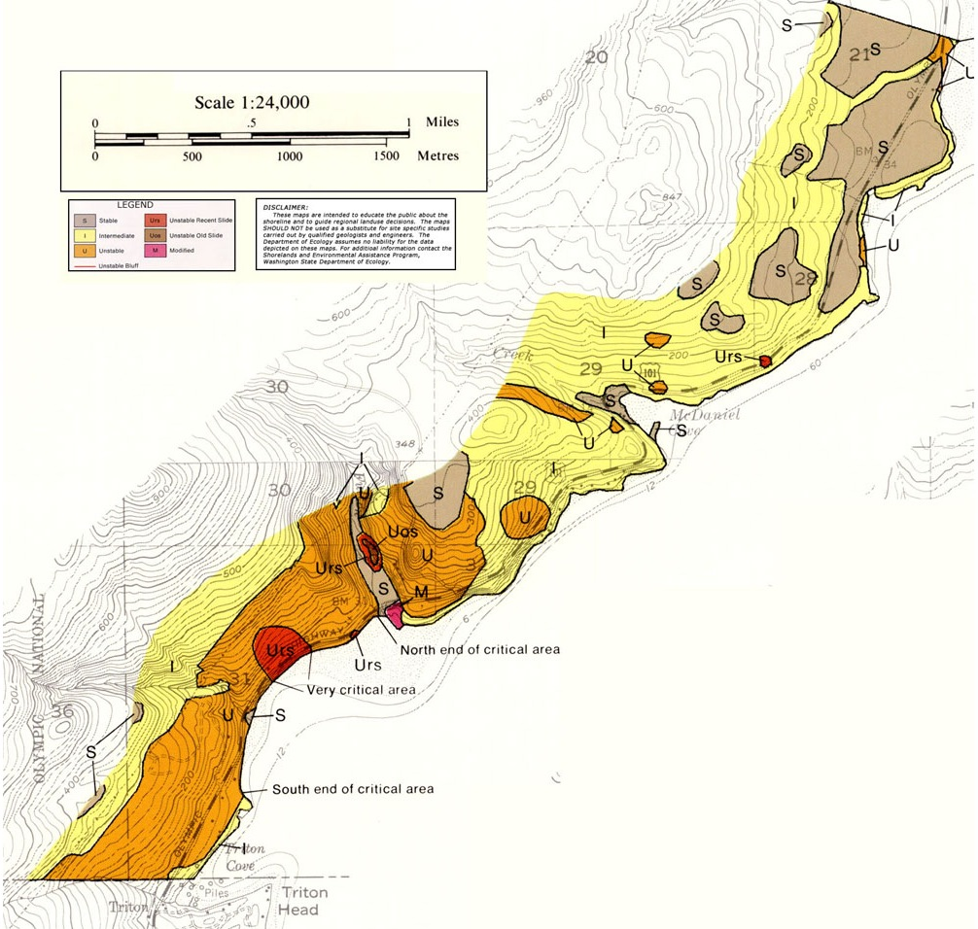
Map-based probabilistic analysis
Soil type, slope, moisture content etc. compared with database of past failures. Probability of failure is estimated
http://www.ecy.wa.gov/programs/sea/femaweb/jefferson.htm

Slide 4
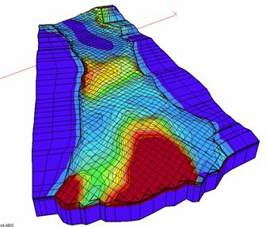
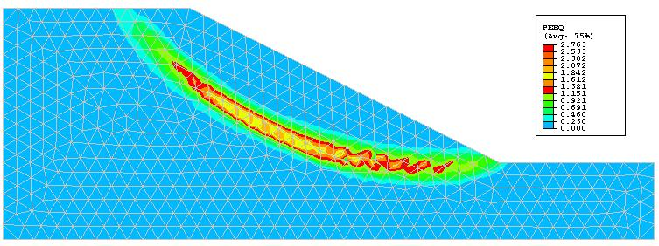
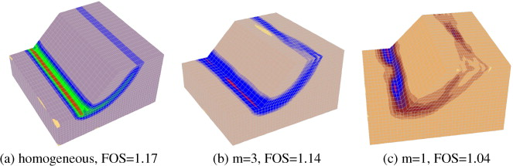
Deformation Analysis
Stress-strain relations, peak-residual strength, anisotropy and other factors are combined to form a model for plastic deformation. Solved with finite element technique

Slide 5

Limit Equilibrium Method
Candidate failure surface is selected
Stresses along failure surface are calculated assuming soil is at limit of static equilibrium (τ)
Total available strength along surface is calculated (s)
Factor of safety is computed as:
Process is repeated until critical failure surface with minimum factor of safety is found
$$FS=\frac{s}{τ}$$

Slide 6
Failure Surfaces

Slide 7
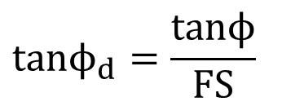
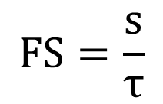
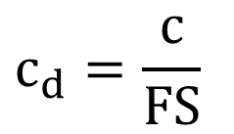
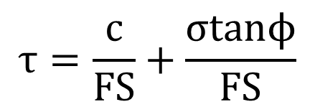
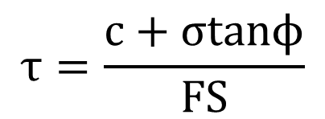
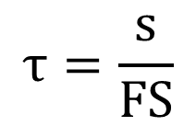
Factor of Safety
$$FS=\frac{s}{τ}$$
$$c_{d}=\frac{c}{FS}$$
$$τ=\frac{s}{FS}$$
$$tanϕ_{d}=\frac{tanϕ}{FS}$$
$$τ=\frac{c+σtanϕ}{FS}$$
c_{d} = developed or mobilized cohesion
tanφ_{d} = developed or mobilized friction
$$τ=\frac{c}{FS}+\frac{σtanϕ}{FS}$$

Slide 8


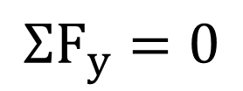
Equilibrium Conditions
Static equilibrium must be satisfied
Three conditions
$$ΣF_{x}=0$$
$$ΣF_{y}=0$$
$$ΣM=0$$
Typically, # equations < # unknowns → simplifying assumptions must be used
Some techniques satisfy all three conditions, some satisfy just a subset

Slide 9
Infinite Slope Analysis

Slide 10
Infinite Slope Analysis
Can be used as a reasonable approximation for cases with:
Shallow firm strata
Cohesionless materials

Slide 11





Infinite Slope Analysis
$$S=Wsinβ$$
$$N=Wcosβ$$
$$W=γ𝓁zcosβ$$
$$S=γ𝓁zcosβsinβ$$
$$N=γ𝓁z\cos^{2}β$$

Slide 12
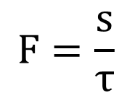
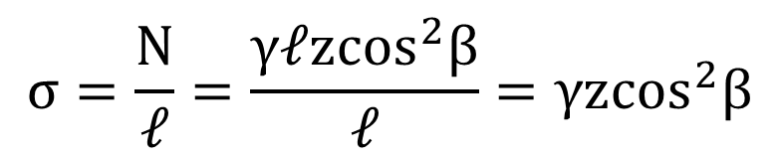
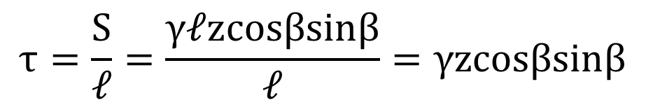
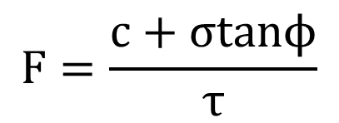
Infinite Slope Analysis
$$τ=\frac{S}{𝓁}=\frac{γ𝓁zcosβsinβ}{𝓁}=γzcosβsinβ$$
$$σ=\frac{N}{𝓁}=\frac{γ𝓁z\cos^{2}β}{𝓁}=γz\cos^{2}β$$
$$F=\frac{s}{τ}$$
$$F=\frac{c+σtanϕ}{τ}$$

Slide 13
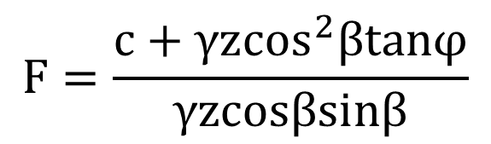
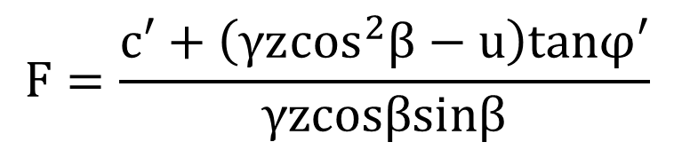
Infinite Slope Analysis
$$F=\frac{c+γz\cos^{2}βtanφ}{γzcosβsinβ}$$
Total Stress Analysis
$$F=\frac{c′+\left(γz\cos^{2}β−u\right)tanφ′}{γzcosβsinβ}$$
Effective Stress Analysis

Slide 14
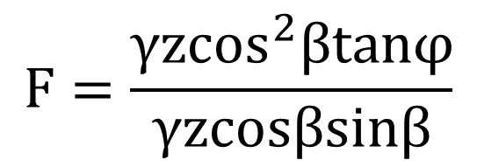
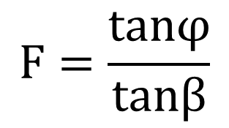
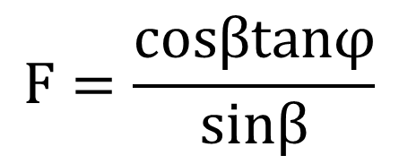
Infinite Slope Analysis
For c=0, u=0:
$$F=\frac{γz\cos^{2}βtanφ}{γzcosβsinβ}$$
$$F=\frac{cosβtanφ}{sinβ}$$
$$F=\frac{tanφ}{tanβ}$$

Slide 15
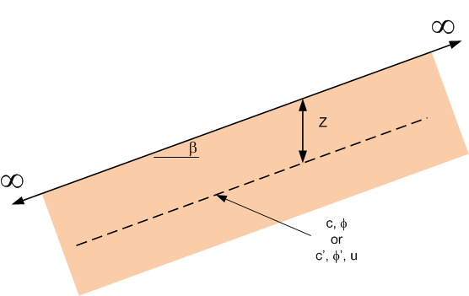
Infinite Slope Analysis

Slide 16
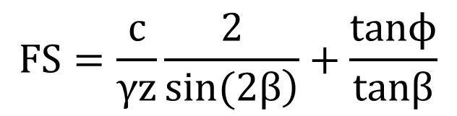

Total Stress Analysis
Non-submerged slopes
Submerged slopes
$$FS=\frac{c}{γz}\frac{2}{\left.sin(2β\right)}+\frac{tanϕ}{tanβ}$$
$$FS=\frac{c}{γ′z}\frac{2}{\left.sin(2β\right)}$$
c = S_{u}, φ = 0

Slide 17
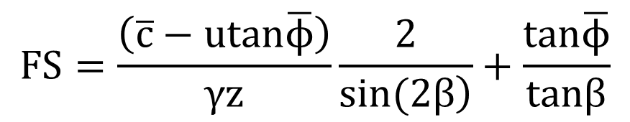
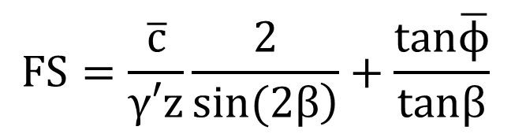
Effective stress analysis
General case
Submerged slopes
$$FS=\frac{\left(\overline{c}−utan\overline{ϕ}\right)}{γz}\frac{2}{\left.sin(2β\right)}+\frac{tan\overline{ϕ}}{tanβ}$$
$$FS=\frac{\overline{c}}{γ′z}\frac{2}{\left.sin(2β\right)}+\frac{tan\overline{ϕ}}{tanβ}$$

Slide 18
Log Spiral Technique

Slide 19
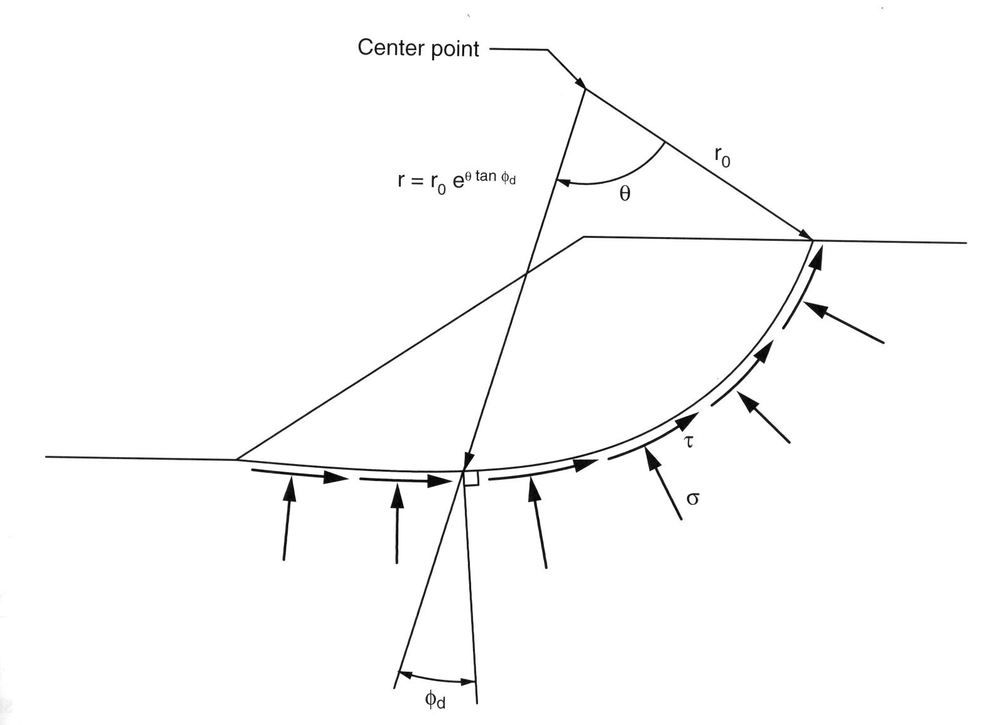
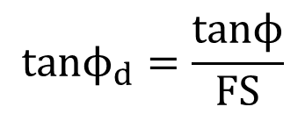
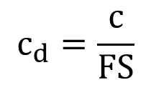
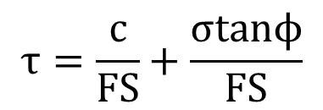
Log Spiral Technique
$$τ=\frac{c}{FS}+\frac{σtanϕ}{FS}$$
$$c_{d}=\frac{c}{FS}$$
$$tanϕ_{d}=\frac{tanϕ}{FS}$$
c_{d} = developed or mobilized cohesion
tanφ_{d} = developed or mobilized friction angle

Slide 20
Log Spiral Technique
Sum moments about center point:
Moment due to wt of soil mass, W
Moment due to mobilized cohesion Cm
Moments due to mobilized friction and normal forces cancel
(1) and (2) give you one equation with one unknown (F), but geometry depends on F so problem is solved iteratively.

Slide 21
Log Spiral Summary
Achieves statically determinate solution by assuming log spiral shape for slope
Explicitly satisfies moment equilibrium; implicitly satisfies force equilibrium
Complete equilibrium
Relatively accurate

Slide 22
Log Spiral Summary, cont.
Best procedure for homogenous slopes
Tough to solve by hand
Popular method for
Charts
Simple programs

Slide 23
Swedish Method (φ=0)

Slide 24


Swedish Method (φ=0)
Applicable to
Saturated soil
Undrained conditions
Can be thought of as special case of log spiral:
0
$$r=r_{o}e^{θtanφ_{m}}$$
(i.e. circular surface)
$$r=r_{o}e^{0}=r_{0}$$

Slide 25
Swedish Method

Slide 26

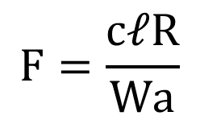
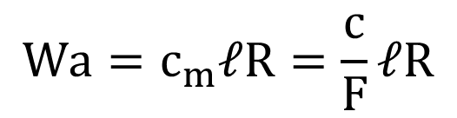
Swedish Method
Sum moments about the center of the circle:
$$Wa−c_{m}𝓁R=0$$
$$Wa=c_{m}𝓁R=\frac{c}{F}𝓁R$$
$$F=\frac{c𝓁R}{Wa}$$
Available resisting moment
=
Actual driving moment

Slide 27

Swedish Method
If c varies along the slope, break up slope and sum the individual moments:
$$F=\frac{R\sum{c}𝓁}{Wa}$$

Slide 28
Swedish Method
Submerged Slopes
Use submerged unit wt. to account for buoyant force
Wa = (γ-γ_{w})Aa
Wa = γ’ Aa
A = Area of sliding mass

Slide 29
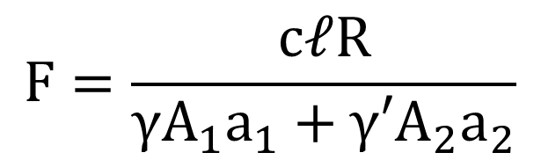
Swedish Method
Partially Submerged Slopes
$$F=\frac{c𝓁R}{γA_{1}a_{1}+γ′A_{2}a_{2}}$$

Slide 30
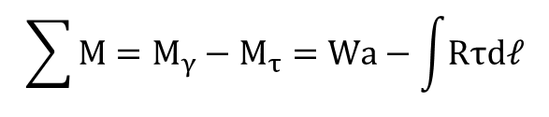
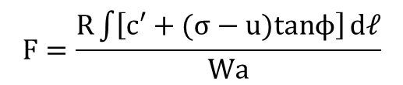
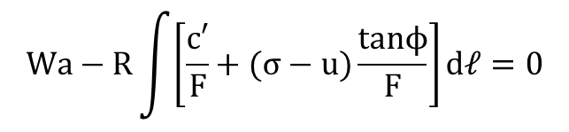
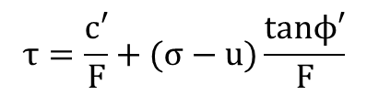
Circular Surface, φ ≠ 0
ΣMoments about center:
Due to weight, M_{γ} = Wa
Due to normal stress, M_{σ} = 0
Due to shear stress,
$$\sum{M}=M_{γ}−M_{τ}=Wa−\int{Rτd𝓁}$$
$$τ=\frac{c′}{F}+(σ−u)\frac{tanϕ′}{F}$$
$$Wa−R\int{\left[\frac{c′}{F}+(σ−u)\frac{tanϕ}{F}\right]}d𝓁=0$$
Note: σ varies along the surface and is unknown so you can’t solve directly for F
$$F=\frac{R\int{\left[c′+(σ−u)tanϕ\right]}d𝓁}{Wa}$$

Slide 31
General Method of Slices

Slide 32
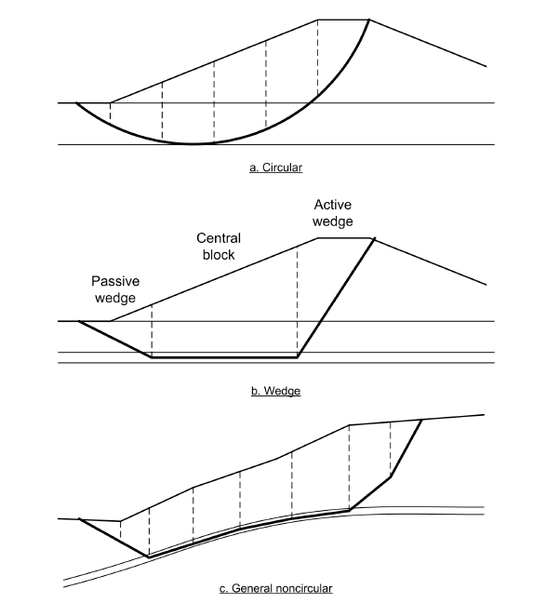
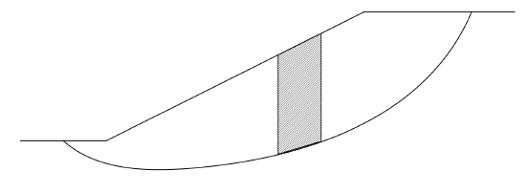
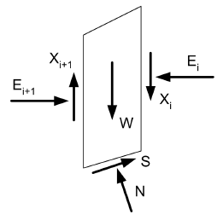
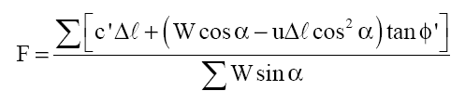
Method of Slices

Slide 33
General Method of Slices
Sign convention:

Slide 34

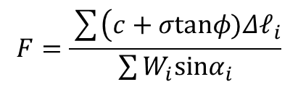

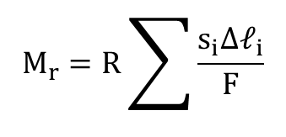

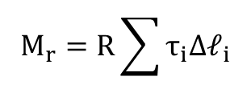
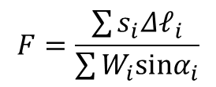
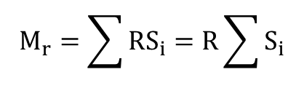
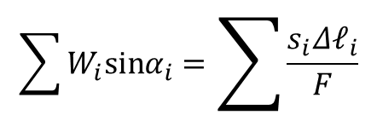
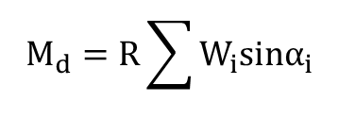
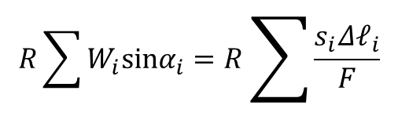
General Method of Slices
Moment arm:
$$M_{d}=M_{r}$$
$$a_{i}=Rsinα_{i}$$
$$R\sum{W_{i}sinα_{i}}=R\sum{\frac{s_{i}Δ𝓁_{i}}{F}}$$
Driving moment:
$$M_{d}=R\sum{W_{i}sinα_{i}}$$
$$\sum{W_{i}sinα_{i}}=\sum{\frac{s_{i}Δ𝓁_{i}}{F}}$$
Resisting moment:
$$M_{r}=\sum{RS_{i}}=R\sum{S_{i}}$$
$$F=\frac{\sum{s_{i}Δ𝓁_{i}}}{\sum{W_{i}sinα_{i}}}$$
$$M_{r}=R\sum{τ_{i}Δ𝓁_{i}}$$
$$s=c+σtanφ$$
$$M_{r}=R\sum{\frac{s_{i}Δ𝓁_{i}}{F}}$$
$$F=\frac{\sum{\left(c+σtanφ)Δ𝓁_{i}\right.}}{\sum{W_{i}sinα_{i}}}$$
← General eq.

Slide 35



General Method of Slices
If φ=0
0
$$F=\frac{\sum{\left(c+σtanϕ)Δ𝓁_{i}\right.}}{\sum{W_{i}sinα_{i}}}$$
$$F=\frac{\sum{cΔ𝓁_{i}}}{\sum{W_{i}sinα_{i}}}$$
This equation is often called the “Swedish Method”
Compare to Swedish Circle equation:
$$F=\frac{c𝓁R}{Wa}$$

